Slide 1

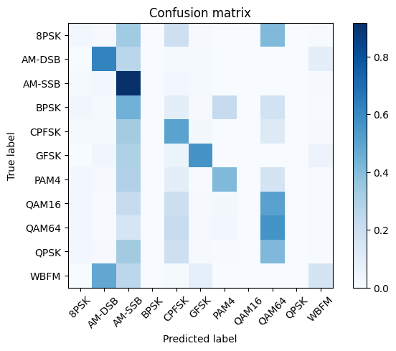
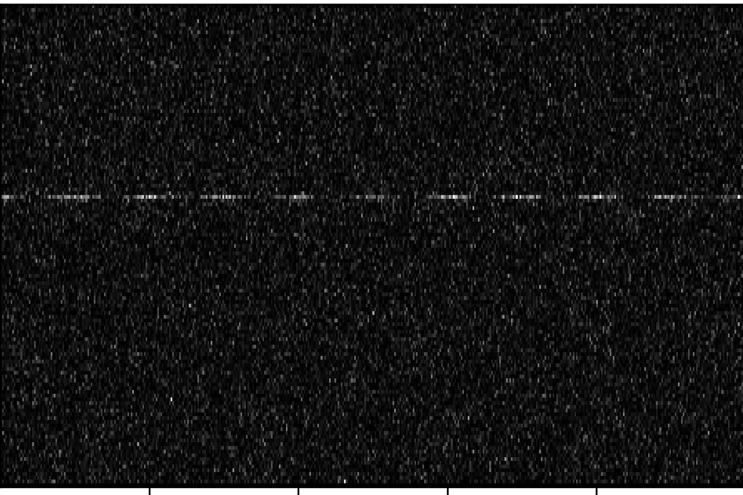
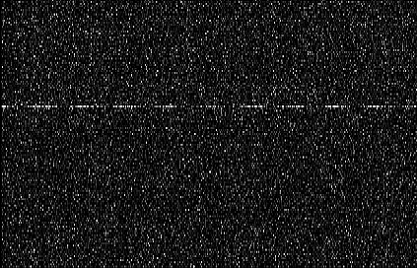
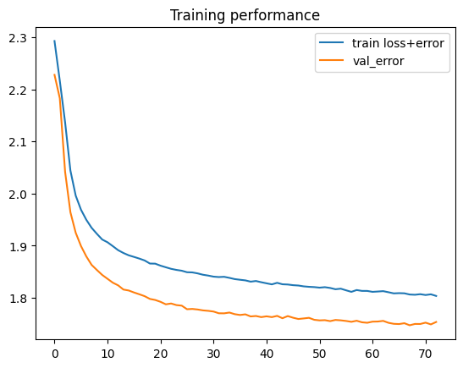
Convolutional Neural Networks for Modulation Classification
Jacob Sueppel, Dr. George Sklivanitis, Center for Connected Autonomy and Artificial Intelligence
HYPOTHESIS
METHODOLOGY
CONCLUSION
Deep learning using a convolutional neural network can be used to accurately classify different signal modulations into ten unique signals with high accuracy.
System able to correctly classify signals with an average accuracy of 95%
Supervised classification deep learning
Convolutional layers meaning patterns will be identified such as edges or right shadow to identify common trends in images
RadioML datasets to train with
Coded using Google Colab’s Jupiter Notebooks
Random noise added to datasets for increased training difficulty
PyTorch model used with wand.ai for training
BACKGROUND
Increase in data usage worldwide has led to more congested signal transfers with thousands of users in small spaces all trying to receive their own signals
Low bandwidth requires more complex system to accurately communicate
Machine learning can be implemented to filter out the noise in unique situations as devices travel to different types of signal congested environments
Other applications such as audio signal detection and pattern recognition
Convolutional neural network will be used as it is especially good with pattern recognition in trends such as these
Opted for trained model rather than untrained as in a real-life scenario the receiver would know the signal type it is looking for
SIGNIFICANCE
Convolution Diagram
Proposes alternative method to filter through for signal with low bandwidth being available
Future studies can be done for the purpose of the KnifeBot swarm technology by processing sound underwater in a similar manner with audio spectrograms
CODING
REFERENCES
Boegner, L., Vanhoy, G., Vallance, P., Gulati, M., Feitzinger, D., Comar, B., & Miller, R. D. (2022). Large scale radio frequency wideband signal detection & Recognition. https://doi.org/10.31219/osf.io/cvus7
Lichtman, M. (n.d.). A guide to SDR and DSP using python. PySDR. Retrieved January 23, 2023, from https://pysdr.org/content/frequency_domain.html.
Spectrum Sensing with Deep Learning to Identify 5G and LTE Signals. MATLAB & Simulink. (n.d.). Retrieved January 23, 2023, from https://www.mathworks.com/help/comm/ug/spectrum-sensing-with-deep-learning-to-identify-5g-and-lte-signals.html.
Supervised machine learning: Regression and classification. Coursera. (n.d.). Retrieved January 23, 2023, from https://www.coursera.org/learn/machine-learning
Vicapow, V. P. (n.d.). Image kernels explained visually. Explained Visually. Retrieved February 13, 2023, from https://setosa.io/ev/image-kernels/
YouTube. (n.d.). MIT introduction to Deep Learning Course. YouTube. Retrieved January 23, 2023, from https://www.youtube.com/playlist?list=PLHkKmgGGVneX2BzZVYGqcWbFw_7ymcZqv
Loss
Original Sample Spectrogram Image
Spectrogram Image put through Sharpen Image Kernel
Steps
Notes:
Talk more about data
types of data
Organize column-wise
Number References
Put them in
Friendly users vs enemy users
Spectrogram usage registration
Usage receiver validation

Slide 2
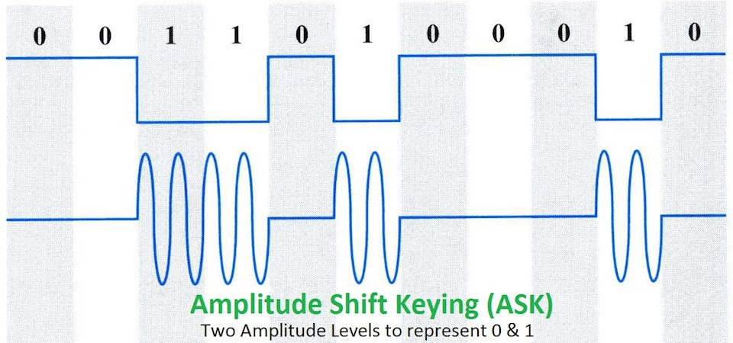
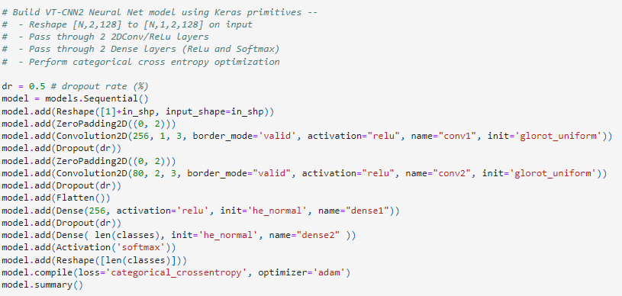
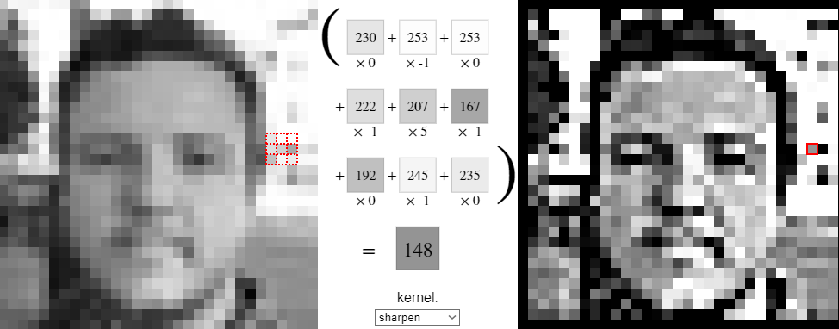
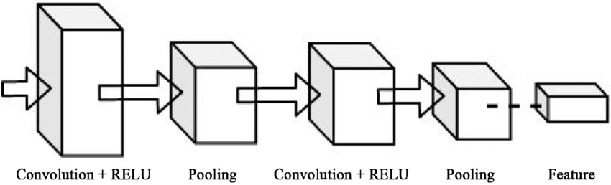
Convolutional Neural Networks for Modulation Classification
Jacob Sueppel, Dr. George Sklivanitis, Center for Connected Autonomy and Artificial Intelligence
BACKGROUND
HYPOTHESIS
CONCLUSION
Deep learning using a CNN(Convolutional Neural Network) can be used to accurately classify different signal modulations into ten unique signals with high accuracy.
System able to correctly classify signals with an average accuracy of 95%
Modulated SDR Signals have a carrier signal which is modulated by a second modular signal to create different common structures
Common forms of modular signals include amplitude, frequency, and phase shifting
METHODOLOGY
Loss
Supervised classification deep learning
Coded using Google Colab’s Jupiter Notebooks
2016.10A RADIOML Dataset
Half of dataset used as training batch
100 epochs training duration
2 Convolutional Layers
2 Dense Layers
Steps
SIGNIFICANCE
[1] Example Amplitude Shift Modulated Signal
Convolutional neural networks operate using image kernels. Image kernels are simply applying a filter to an image to highlight a certain feature such as sharpening the overall image, highlighting outlines, or emphasizing shadows in a particular direction
These filtered images are then compared in a neural network to classify objects
Signal Monitoring Usage
Friend vs. Foe
Usage registration
Usage receiver validation.
REFERENCES
[1] Pritchard, Mykel. “Intro to SDR and RF Signal Analysis.” Elttam, 15 June 2017, https://www.elttam.com/blog/intro-sdr-and-rf-analysis/.
[2] Powell, Victor. “Image Kernels Explained Visually.” Setosa.io, 2015, https://setosa.io/ev/image-kernels/.
[3] O'Shea, Tim. “Examples/rml2016.10a_vtcnn2_example.Ipynb at Master · Radioml/Examples.” GitHub, 12 Sept. 2016, https://github.com/radioML/examples/blob/master/modulation_recognition/RML2016.10a_VTCNN2_example.ipynb.
[4] Islam, Rafiqui. “Detection and Classification of Brain Tumor Based on Multilevel ...” Research Gate, Jan. 2020, https://www.researchgate.net/publication/341019121_Detection_and_Classification_of_Brain_Tumor_Based_on_Multilevel_Segmentation_with_Convolutional_Neural_Network.
[3] Training Parameters for CNN
[2] Example Sharpen Image Kernel
Softmax
[4] CNN Diagram
Notes:
https://www.elttam.com/blog/intro-sdr-and-rf-analysis/

